Slide 1
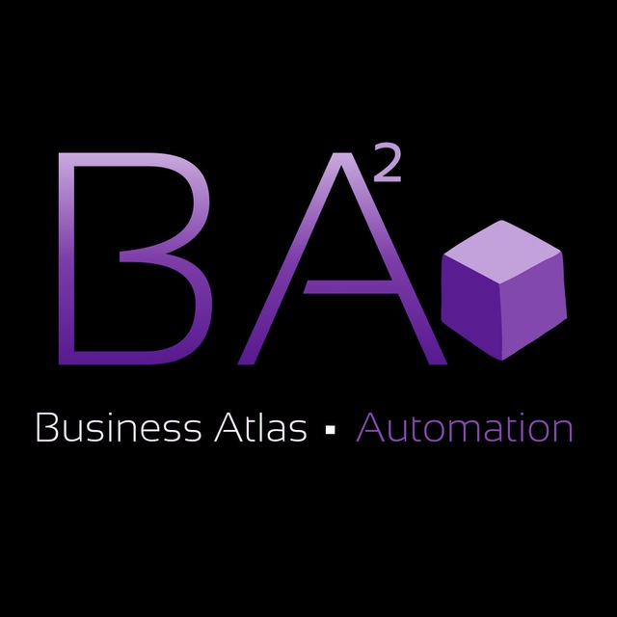
PROJECT PROPOSAL
Guest Feedback & Profile Intelligence System
Client: Singita Date: June 24, 2026
System. Control. Results.

Slide 2
CLIENT SITUATION
Guest feedback is rich, but most of it never reaches a system
⚠
⏱
📉
Conversational Feedback Gets Lost
Disconnected Systems
Manual, Fragmented Logging
Most real feedback happens in live conversations with staff or over WhatsApp and email. Singita never pushes guests for reviews — so this is the majority of guest sentiment, and almost none of it is captured.
Booking (PMS), guest reviews (Loop) and guest profiles don’t talk to each other. Staff can’t see at a glance that a returning guest likes strawberries or had a complaint last visit.
Handwritten guest cards are retyped into Loop, then exported into giant Excel files. Loop only returns word clouds — no real trends, no recommendations, no way to ask a question and get an answer.
Business Atlas Automation • businessatlas.space
2

Slide 3
SOLUTION
A private guest feedback & profile system
What’s included:
• Voice & text note capture via WhatsApp/Telegram
• AI-structured guest profile (preferences, history, notes)
• Trend analytics across lodges and regions
• Private, closed infrastructure — not public AI tools
Result
✓ No conversation or note gets lost again
✓ One guest view across all lodges and visits
✓ Ask a question, get a real answer — not a word cloud
Business Atlas Automation • businessatlas.space
3

Slide 4
HOW IT WORKS
From a guest conversation to actionable insight
01
Capture
Voice or text, in seconds
Staff log a note by voice or text in WhatsApp/Telegram — right after a guest mentions a preference or complaint.
02
Structure
One profile, every visit
AI structures the note into the guest profile and tags it — preference, complaint, or request — no manual retyping.
03
Ask & Analyze
Insight, not word clouds
Managers ask the AI agent directly: “What issues keep coming up at Lebombo?” or “Brief me on this guest’s last 5 visits.”
Business Atlas Automation • businessatlas.space
4

Slide 5
IMPLEMENTATION PACKAGES
Three ways to start, scaled to your timeline
START
$5,000 setup
2–3 weeks
No-code MVP (Voiceflow/Botpress + n8n): guest profile, text notes, AI summary.
HYBRID
$11,000 setup — Recommended
4–6 weeks
Self-hosted (LangGraph + Supabase): + voice notes, AI chat agent, dashboard.
ENTERPRISE
$18,000 setup
8–10 weeks
Full custom build (Python/FastAPI): + AI-drafted replies, integration-ready.
Business Atlas Automation • businessatlas.space
5

Slide 6
SUPPORT PACKAGES
Ongoing care, matched to your chosen package
BASIC
$400 / month
For START tier
Bug fixes & uptime monitoring. 48h response time.
STANDARD
$800 / month
For HYBRID tier
Fixes + minor tweaks. 24h response, monthly review.
PRIORITY
$1,500 / month
For ENTERPRISE
Fixes + new features. Same-day response, quarterly strategy call.
Business Atlas Automation • businessatlas.space
6

Slide 7
PAYMENT SCHEDULE
Same structure for every package: 50% / 30% / 20%
Stage
START • HYBRID • ENTERPRISE
Deposit (50%) — before work starts
$2,500 •$5,500 • $9,000
Implementation (30%)
$1,500 • $3,300 • $5,400
Launch (20%) — on delivery
$1,000 • $2,200 • $3,600
TOTAL
$5,000 • $11,000 • $18,000
Setup fee only. Monthly support retainer billed separately, starting after launch.
Business Atlas Automation • businessatlas.space
7

Slide 8
SECURITY & ARCHITECTURE
Built for guests who value their privacy
01
Private, closed infrastructure — not a public AI tool. Guest data never trains a public model and isn’t visible outside Singita’s own system.
02
Built with POPIA and GDPR requirements in mind from day one — appropriate for guest contact details, locations, and preferences.
03
Human-to-guest, always. The system never sends guests a message — it only helps your team respond, personally, faster.
Business Atlas Automation • businessatlas.space
8

Slide 9
WHY THIS PAYS OFF
The price is an investment, not a cost
01
At $2,200–$3,800+ per guest, per night, knowing what a returning guest wants before they ask is worth more than the system costs.
02
The alternative is more staff hours retyping cards into Loop and Excel — this replaces that work instead of adding to it.
03
Built to plug into whatever PMS/CRM Singita chooses next — no rework needed when that migration happens.
Business Atlas Automation • businessatlas.space
9

Slide 10
ABOUT US
We build systems, not just configure tools
Business Atlas Automation is a B2B agency for AI automation and CRM integration. We free business owners from operational routine through end-to-end automation.
50+
3+
UA/EU
Projects
Years of Experience
Markets
Business Atlas Automation
Architect of digital business ecosystems
Stack: n8n · Make · Dynamics 365 · Creatio · Webflow · Claude AI · OpenAI
Business Atlas Automation • businessatlas.space
10

Slide 11
WHAT WE NEED FROM YOU
Just one decision to get started
1
Choose your package — START, HYBRID, or ENTERPRISE
2
Confirm your choice in writing
3
We’ll send over the access & data checklist next
4
Deposit received — we start the same day
Business Atlas Automation • businessatlas.space
11

Slide 12
TERMS OF COOPERATION
Transparent. No hidden terms.
💳 Payment in 3 Stages
📋 Documentation
50% deposit, 30% at implementation, 20% on launch. Protects both sides.
Every project ships with a description of what was set up and how.
🛡 14-Day Warranty
⏱ Deadlines
If something doesn’t work after delivery, we fix it free of charge.
Timelines are fixed at the start, and we stick to them.
Business Atlas Automation • businessatlas.space
12

Slide 13
Ready to Start?
We respond within 4 business hours.
Business Atlas
Automation
🌐 https://businessatlas.space/
System. Control. Results.
50+ projects • UA / EU • n8n · CRM · AI

